Slide 1
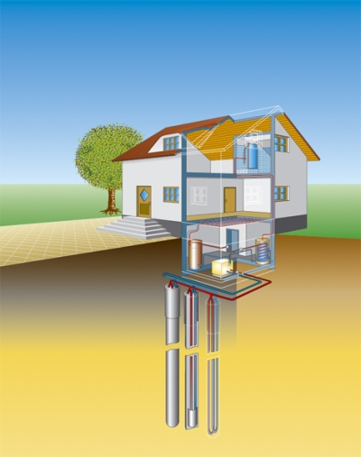
Geothermal energy in private homes
Presentation for
“Energy and the Environment“
Nov. 29th 2011
by
Kira Quint and Oliver Ricken
Source: erdwaerme-info.de

Slide 2
Outline
Introduction and motivation
Heat
  Generation
  Distribution and mechanisms of transport
Usage and applications of geothermal energy
  Accessing geothermal sources
  Industrial use
Geothermal energy in private homes
Risks

Slide 3
Introduction and motivation
What is geothermal energy?
Motivation to use it:
  Renewable
  No (to few in total balance) emissions
  (Nearly) everywhere accessible
Generated by earth itself
Thermal energy in form of heat

Slide 4
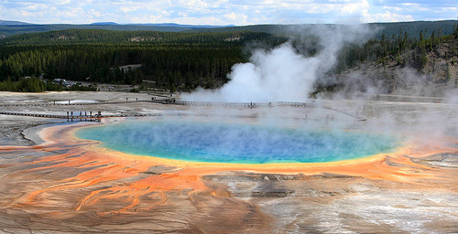
Introduction and motivation (2)
Average heat flux through earth‘s surface:
Total energy for the earth:
result
vs.
Total energy consumption estimated for 2006:
Source: all-geo.org

Slide 5
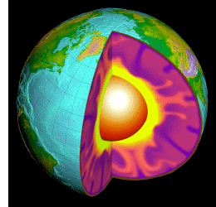
Heat flow - Generation
Remnant heat from formation of the core
heat from decay of long-lived radioactive isotopes
Plate tectonics (friction)
Exothermal reactions
Oceanic crust
Continantel crust
Lower mantle
Upper mantle
Source: usgs.gov

Slide 6
Generation of heat –
Formation of the core
Long-lived Radioactive isotopes
  Decay
  Collisions of decay products with atoms
Molten iron migrating to the center
  forming its liquid core
  releasing gravitational potential energy
Core slowly cooling down forming
  solid inner core
  liquid outer core
Heat is generated
(ca. 40% of g.e. used heat)
Notes:
Ocenanic crust formed directly form the mantle which is low on radioactive elements
Remaining 60% derive from decay of long-lived isotopes (K, Rb, Th, U) in the continental crust

Slide 7
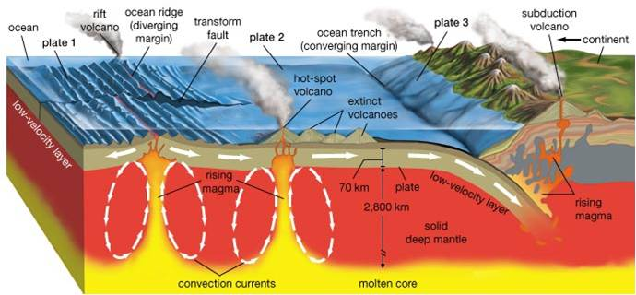
Generation/distribution of heat –
Plate tectonics
Source: V. Rufus, M. Hansen, N. Strotjohann
Notes:
hot content from the mantle is brought up at spreading centres
cool rocks are carried down at subduction zones
→ definition of major tectonic plates

Slide 8
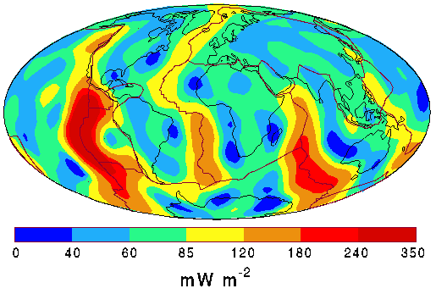
Distribution of heat flow –
Global heat flow
Source: lbl.gov
Notes:
Most geothermal power plants are located at earth quake locations
indicating plateboundaries or volcano spots due to large heat flow
(measured heat flow at spreading centres: up to 300 mW/m^2)

Slide 9
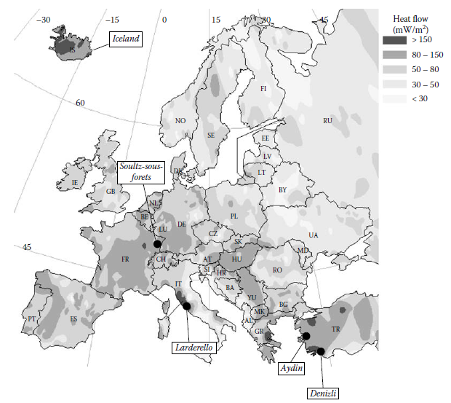
Distribution of heat flow - Europe
Source: W. E. Glassley, Geothermal Energy, 2010

Slide 10
Transport of heat – Theory

Slide 11
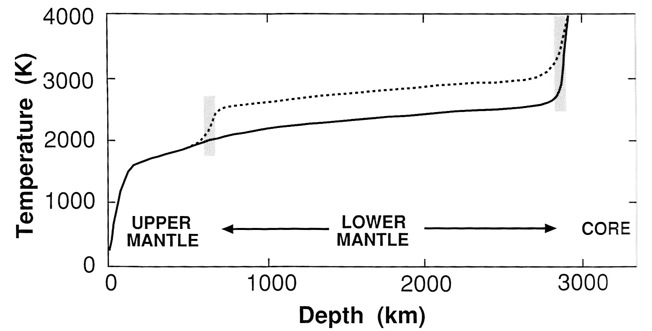
Transport of heat - Temperature profile
Source: C.M.R. Fowler, The solid earth, 2005
Notes:
Figure: model of temperature profile in earth + legend: different models, temperature gradient through the upper mantle approx. adiabatic

Slide 12
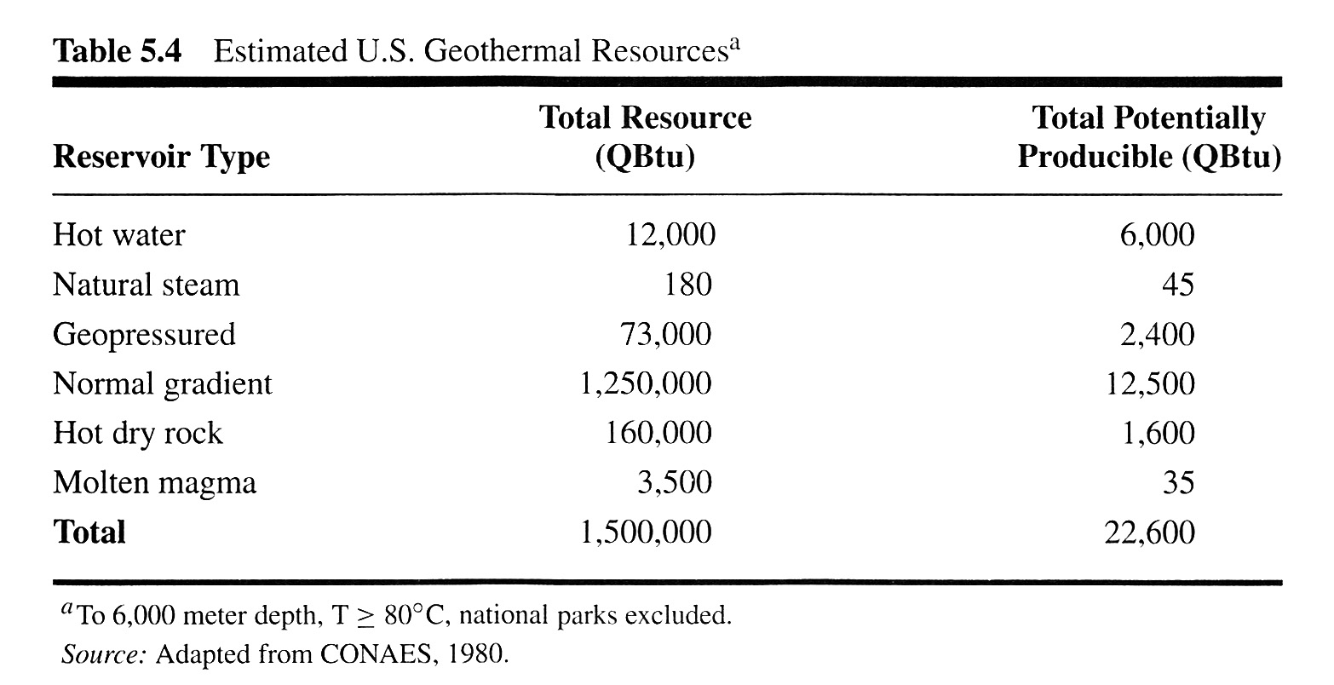
Heat Storage inside the earth
Source: R.A. Ristinen, J.J. Krausharr, Energy and the environment, 1999

Slide 13
Exploration of geothermal sites
Geological information (e.g. concentration of certain silica or certain isotopes)
Geophysical information (e.g. e/m and seismic surveys) - applied geophysics
Geothermal information (drilling to measure temp. grad.)
Private homes: „geologischer Dienst NRW“
Notes:
Silica – Quarz, Feuerstein, Kieselerde

Slide 14
Application of geothermal energy
Source: erdwaerme-info.de

Slide 15
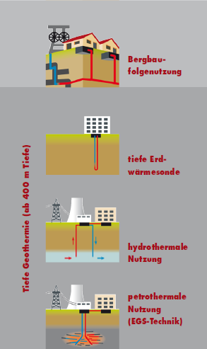

Usage and application of g.e. - Deep
Direct application (industrial)
Generation of electrical power e.g. for the grid
Source: gd.nrw.de

Slide 16
Usage and application of g.e. - Europe
Geothermal power plants
Source: W. E. Glassley, Geothermal Energy, 2010

Slide 17
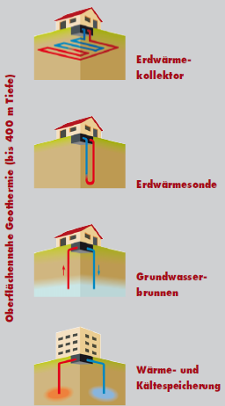
Usage and application of g.e. –
Close-to-surface
Heating, ventilation & air conditioning (HVAC)
  ground source heat pumps
  open or closed systems
Storage of heat
  Variation of temperature on surface
  Constant temperature in earth
Source: gd.nrw.de

Slide 18
Usage and application of g.e. –
Heating and cooling
Heating:
  Cold water is pumped through temperature gradient inside earth to heat up
  Hot water used for room/floor heating or to supply warm water
Cooling:
  Cold water from close-to-surface reservoirs used for air conditioning

Slide 19
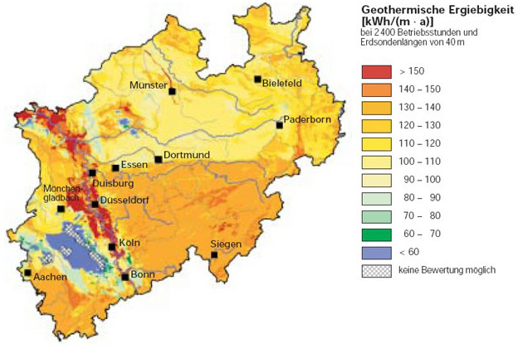
Geothermal energy in private homes – Exploitation (1)
Source: gd.nrw.de
Notes:
Exploitation- erschließung

Slide 20
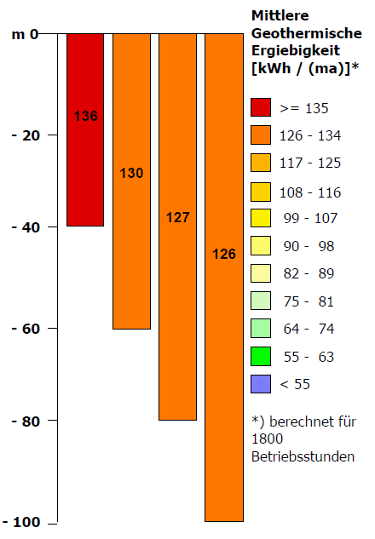
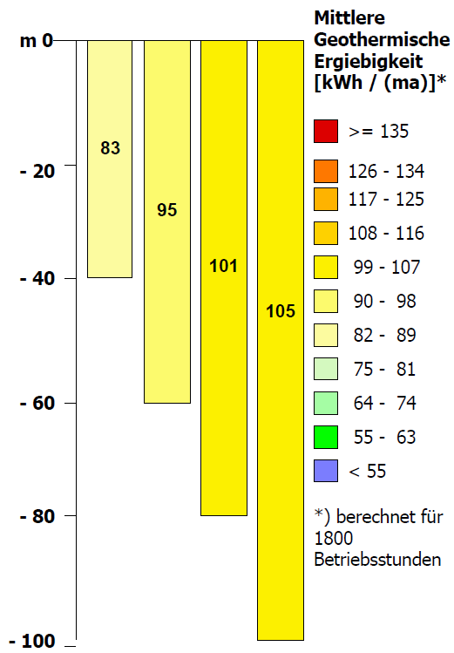
Geothermal energy in private homes – Exploitation (2)
(i)
(ii)
Source: gd.nrw.de
Notes:
Geothermal probes

Slide 21
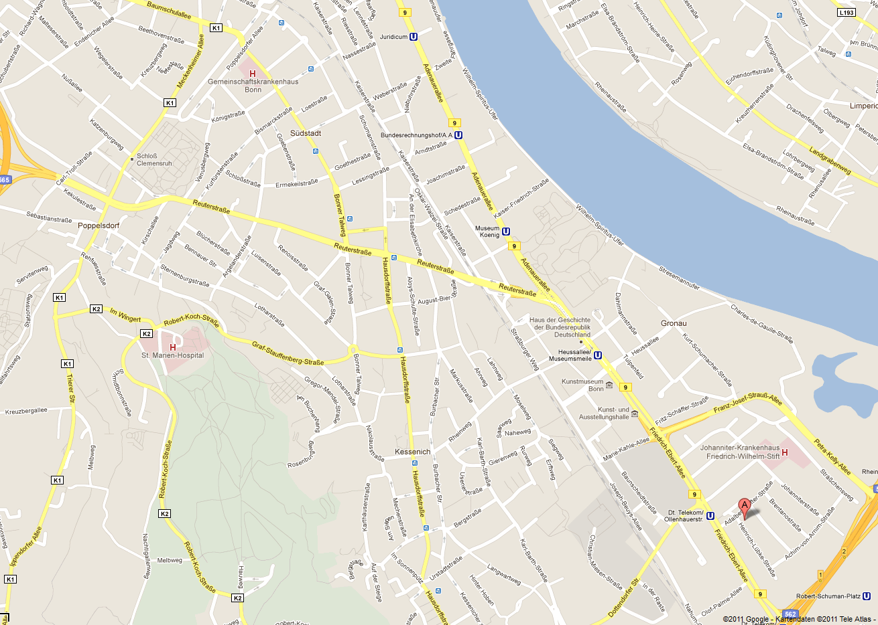
Geothermal energy in private homes – Exploitation (3)
(ii)
(i)

Slide 22

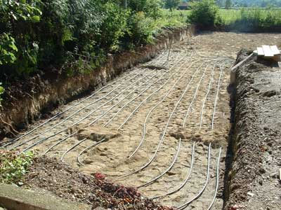
Geothermal installations (1)
Collector:
  Closed system
  Installed below local ground frost level
  Sun radiation and rain fall heat up the ground
  Heat flow per area used to heat/cool water
  Area of installation twice as large as heated residental property
Source: ipp.mpg.de

Slide 23

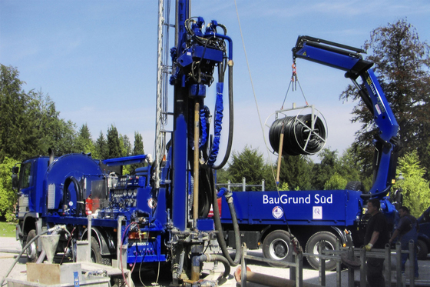
Geothermal installations (2)
Probe:
  Installed in areas where collectors do not suffice
  Drill hole holds two from each other isolated tubes
  Circulation of water-chemical mixture (closed system)
  Expensive
  To increase efficency many tubes are combined in one hole
Source: hausbauunternehmen.info

Slide 24
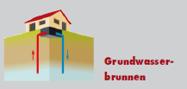
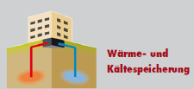
Geothermal installations (3)
Groundwater well
  Groundwater is pumped up and down
  Open system
Water storage
  Storage of water in different depths with different temperatures

Slide 25
Example of a single family home
Calculation (after 20 years):
  Installation costs (incl. pump):
  Annual costs (pump):
  Alternative heating System:
  with annual operating costs:
+19,200 €
+ 20 x 500 € = +10,000 €
-6,830 €
20 x 1,200 € = -24,000 €
-1,630 €

Slide 26
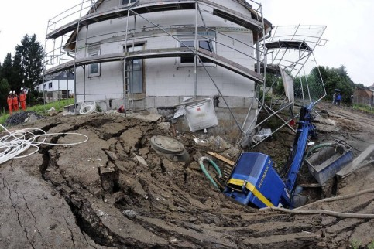
Risks – General (1)
Changing integraty of the ground due to drilling
Changing the flow of groundwater
M=3.4 earthquake in Basel
Source: welt.de

Slide 27
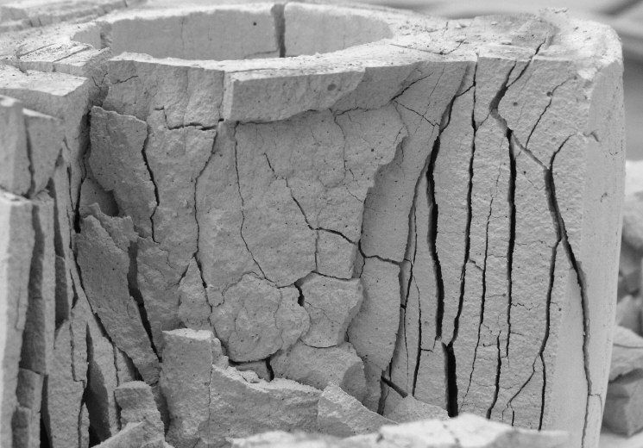
Risks – General (2)
Damage of filling material in drill holes due to change in environmental circumstances
Source: geothermie-nachrichten.de

Slide 28
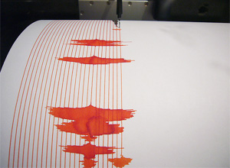
Risks – Open systems
Oaklahoma Earthquake M=5.6 due to Hydraulic Fracturing
    Pumping water into the earth to shatter sediment layers containing natural gas
    Open system in geothermal applications = pumpig water into the earth!
Source: nature.com

Slide 29
Summary (or Pros and Cons)
Pros
Renewable
Saves money longterm
No direct effect on the environment
Versatile in its application
Almost everywhere accessable
Cons
High installation costs
Might have an effect on the earth‘s integraty
No substitution for other electricity generating sources
Strong dependance on the circumstances

Slide 30

Geothermal energy in private homes
Thank you for your attention!
Any questions?
See ya!

Slide 31
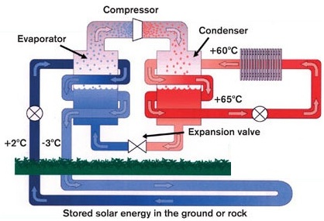
Appendix – Principle of a GSHP (1)
Basic idea:
  Inverse Carnot cycle
  Mech. work is used to transfer heat from lower T to higher T reservoir (e.g. 2°C to 60°C)
Requirement
  Fluid with low temp. of ebullition (e.g. propane)
Source: rjsheating.co.uk

Slide 32
Appendix – Principle of a GSHP (2)
Fluid at high p, low T is pumped through warmer ground → heat intake, evaporation (-3°C→ +2°C)
Gaseous fluid is compressed → condensation, heat output to heating system
T in heating cycle increases
Source: rjsheating.co.uk

Slide 33
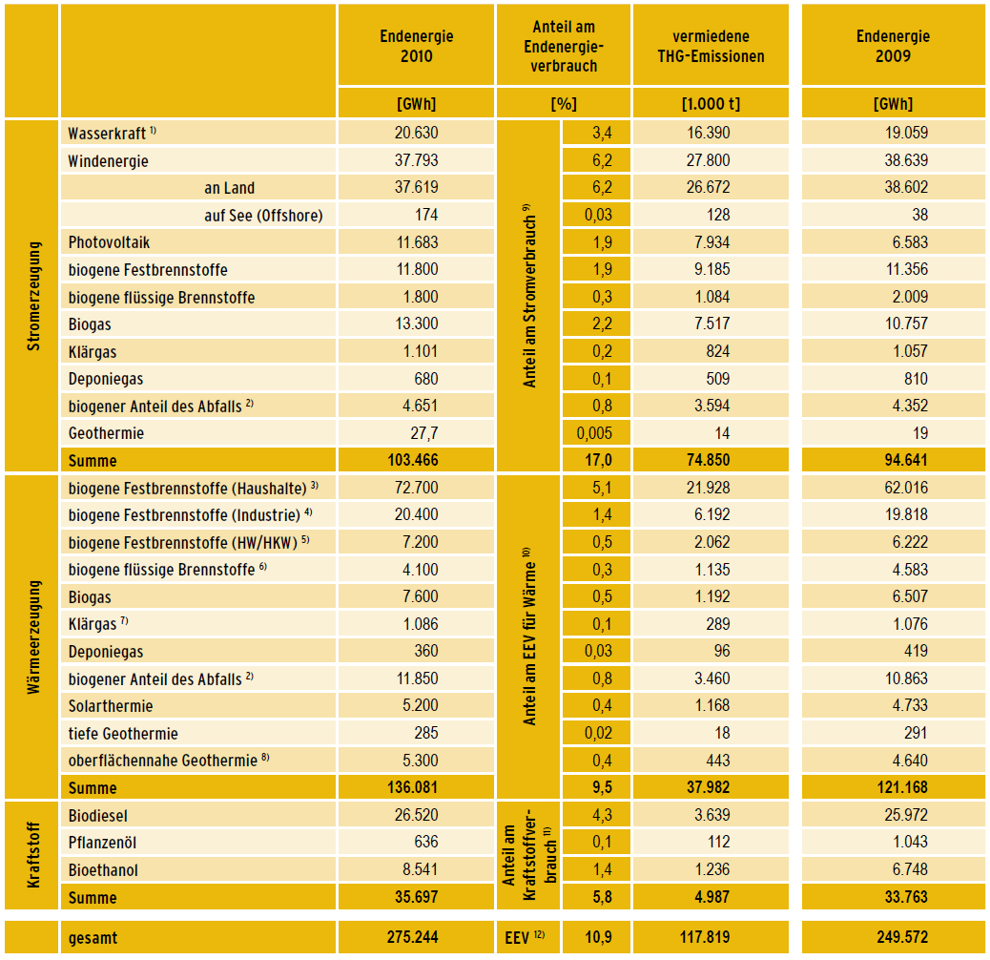
Appendix –
Geothermal energy in Germany
G.e. relative to other renewable energies(July 2011)
  0.027% in electricity
  4.1% in heating
Source: bmu.de

